Slide 1
UNIT 2
Inter Process Communication

Slide 2
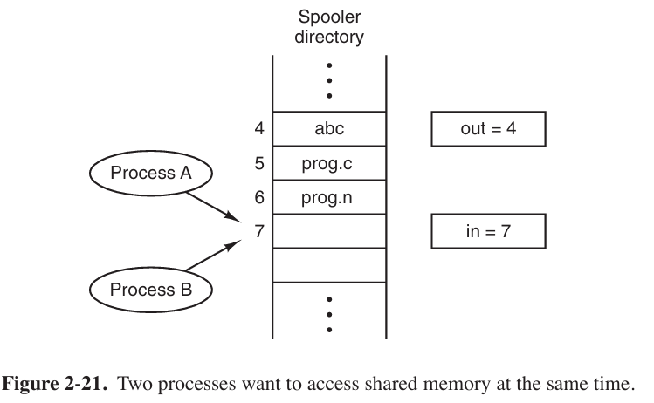
Processes frequently need to communicate with other processes.
For example, in a shell pipeline, the output of the first process must be passed to the second process, and so on down the line.
Thus there is a need for communication between processes, preferably in a well-structured way not using interrupts.
Race Conditions
processes that are working together may share some common storage that each one can read and write.
The shared storage may be in main memory (possibly in a kernel data structure) or it may be a shared file.
let us now consider a simple but common example: a print spooler.
When a process wants to print a file, it enters the file name in a special spooler directory. Another process, the printer daemon, periodically checks to see if there are any files to be printed, and if there are, it prints them and then removes their names from the directory.
Imagine that our spooler directory has a very large number of slots, numbered 0, 1, 2, ..., each one capable of holding a file name.
Imagine that there are two shared variables, out, which points to the next file to be printed, and in, which points to the next free slot in the directory.
At a certain instant, slots 0 to 3 are empty (the files have already been printed) and slots 4 to 6 are full (with the names of files queued for printing).

Slide 3
In jurisdictions where Murphy’s law† is applicable, the following could happen.
Process A reads in and stores the value, 7, in a local variable called next free slot.
Just then a clock interrupt occurs and the CPU decides that process A has run long enough, so it switches to process B.
Process B also reads in and also gets a 7. It, too, stores it in its local variable next free slot.
At this instant both processes think that the next available slot is 7.
Process B now continues to run. It stores the name of its file in slot 7 and updates in to be an 8. Then it goes off and does other things.
Eventually, process A runs again, starting from the place it left off. It looks at next free slot, finds a 7 there, and writes its file name in slot 7, erasing the name that process B just put there.
Then it computes next free slot + 1, which is 8, and sets in to 8.
The spooler directory is now internally consistent, so the printer daemon will not notice anything wrong, but process B will never receive any output.
Situations like this, where two or more processes are reading or writing some shared data and the final result depends on who runs precisely when, are called race conditions.

Slide 4
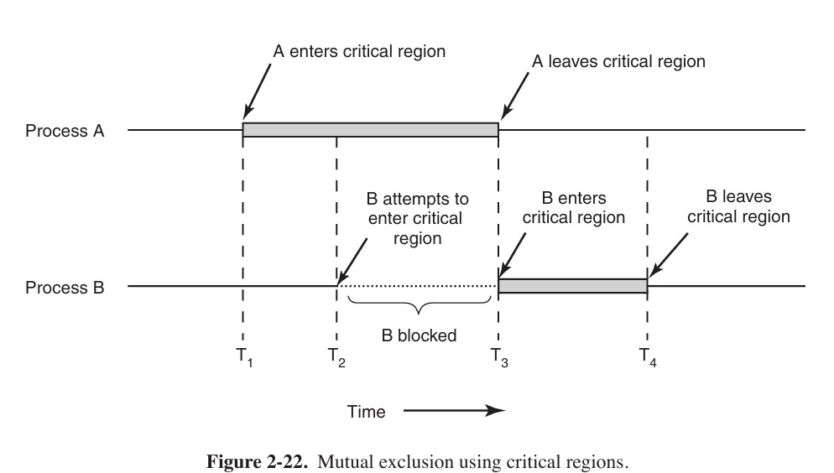
Critical region
That part of the program where the shared memory is accessed is called the critical region or critical section.
If we could arrange matters such that no two processes were ever in their critical regions at the same time, we could avoid races.
Unfortunately, with increasing parallelism due to increasing numbers of cores, race condition are becoming more common.
How do we avoid race conditions?
what we need is mutual exclusion, that is, some way of making sure that if one process is using a shared variable or file, the other processes will be excluded from doing the same thing.
Four conditions to hold to have a good solution:
No two processes may be simultaneously inside their critical regions.
No assumptions may be made about speeds or the number of CPUs.
No process running outside its critical region may block any process.
No process should have to wait forever to enter its critical region.

Slide 5
Mutual Exclusion with busy waiting
while one process is busy updating shared memory in its critical region, no other process will enter its critical region and cause trouble.
Disabling Interrupts-
each process dis able all interrupts just after entering its critical region and re-enable them just be fore leaving it.
with interrupts turned off the CPU will not be switched to another process.
This approach is generally unattractive because it is unwise to give user processes the power to turn off interrupts.
What if one of them did it, and never turned them on again? -That could be the end of the system.
if the system is a multiprocessor (with two or more CPUs) disabling interrupts affects only the CPU that executed the disable instruction. The other ones will continue running and can access the shared memory.
On the other hand, it is frequently convenient for the kernel itself to disable interrupts for a few instructions while it is updating variables or especially lists.
Disabling Interrupts is not appropriate as a general mutual exclusion mechanism for user processes.

Slide 6
Lock Variables
software solution
having a single, shared (lock) variable, initially 0.
When a process wants to enter its critical region, it first tests the lock.
If the lock is 0, the process sets it to 1 and enters the critical region.
If the lock is already 1, the process just waits until it becomes 0
Thus, a 0 means that no process is in its critical region, and a 1 means that some process
Unfortunately, this idea contains exactly the same fatal flaw that we saw in the spooler directory.
Suppose that one process reads the lock and sees that it is 0. Before it can set the lock to 1, another process is scheduled, runs, and sets the lock to 1.
When the first process runs again, it will also set the lock to 1, and two processes will be in their critical regions at the same time.

Slide 7
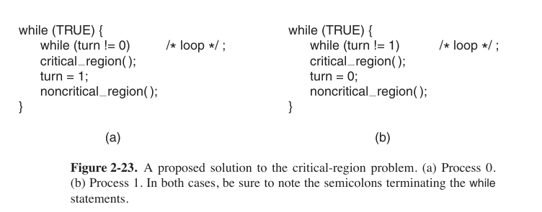
Strict Alternation
the integer variable turn, initially 0, keeps track of whose turn it is to enter the critical region and examine or update the shared memory.

Slide 8
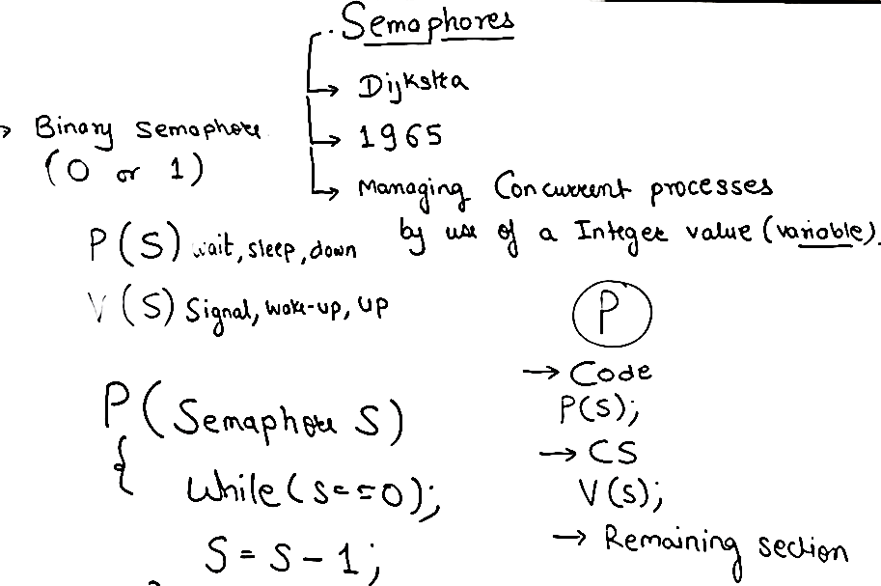
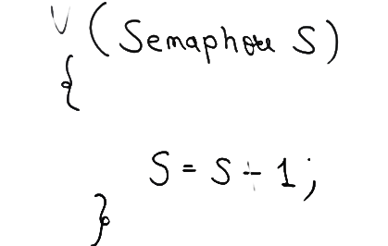
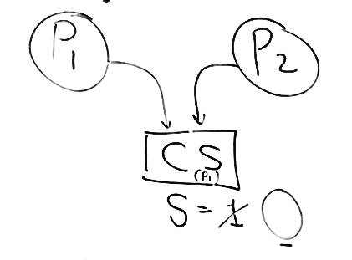

Slide 9
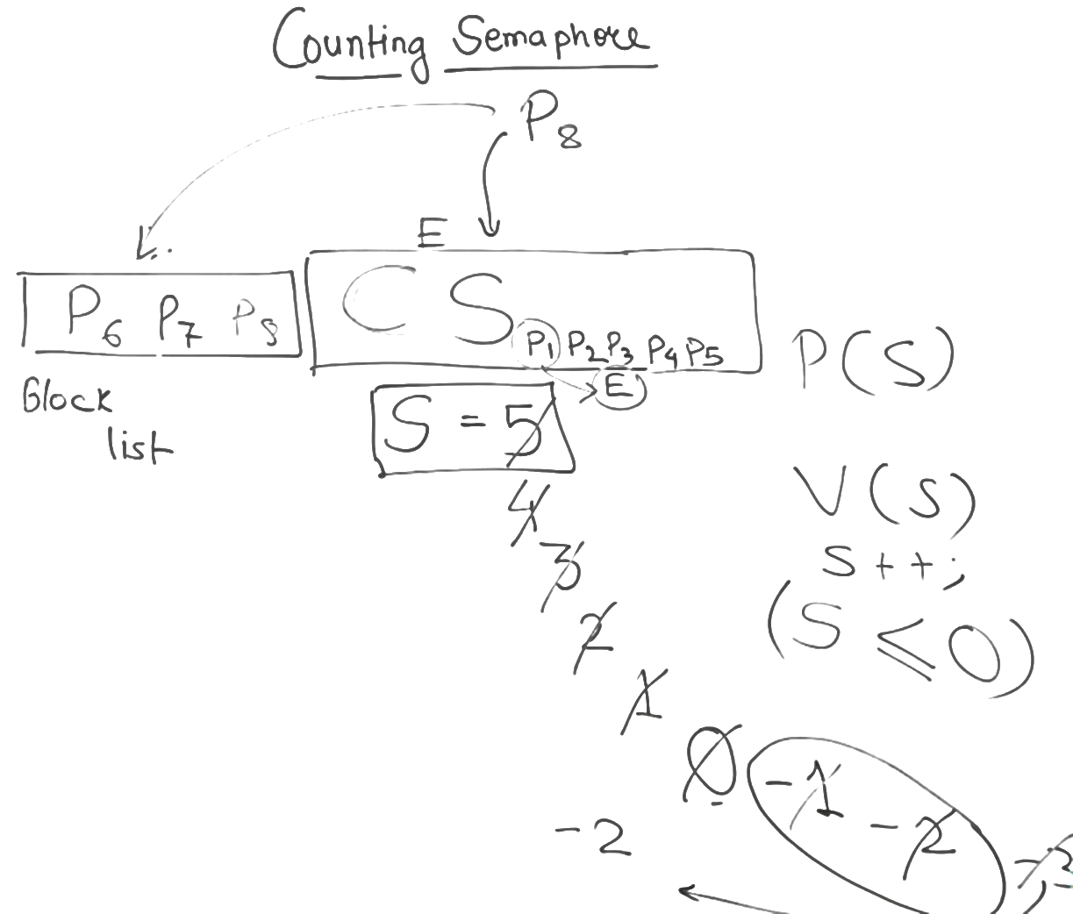

Slide 10
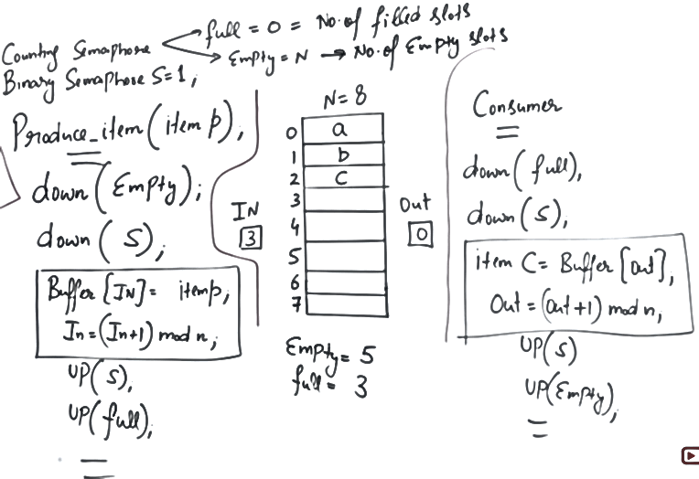
Producer consumer problem using semaphore

Slide 11
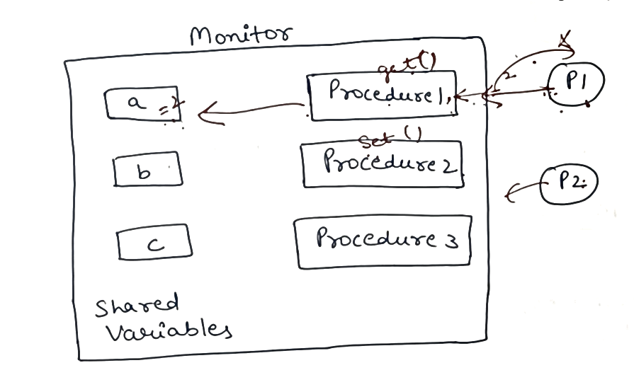
Monitors

Slide 12
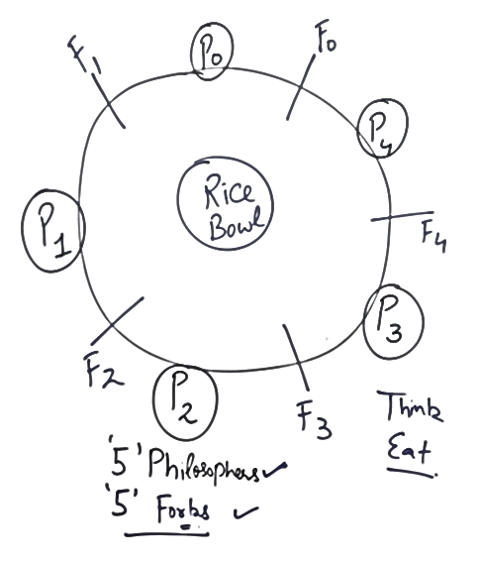
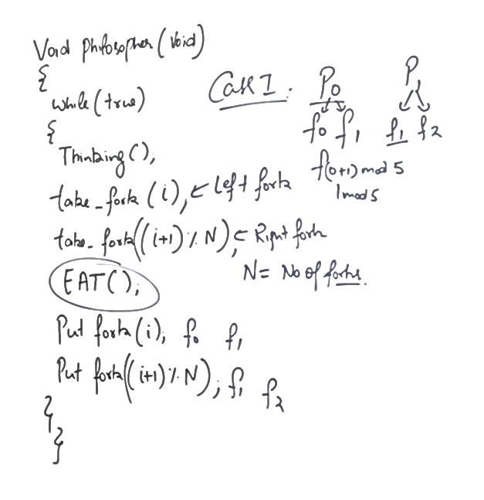
Round robin

Slide 13
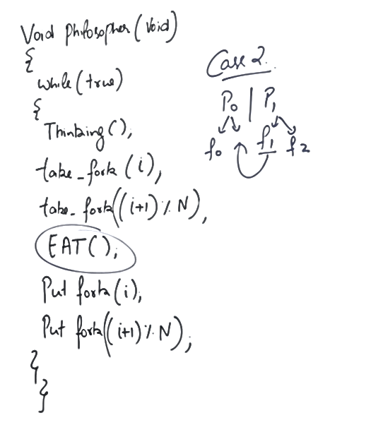

Slide 14
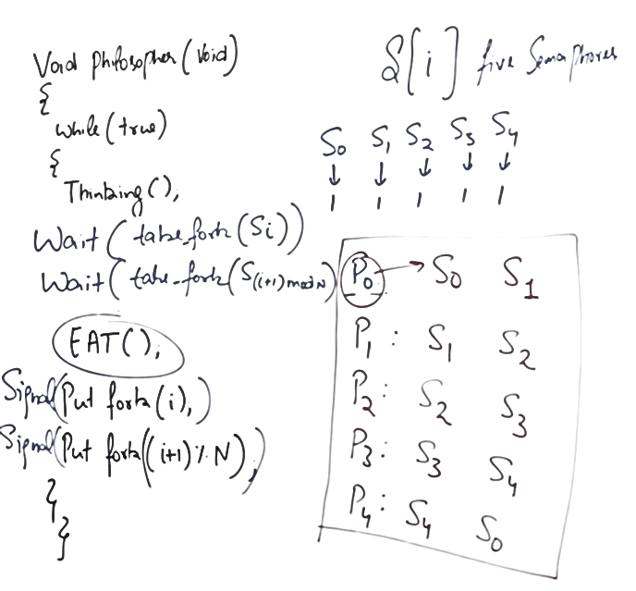


Slide 15
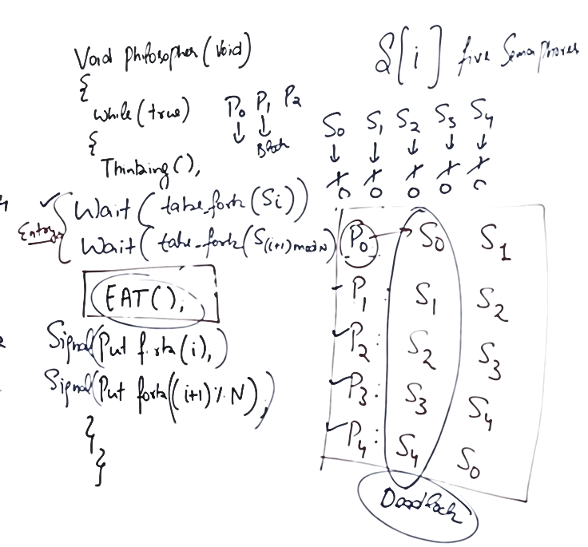
Deadlock

Slide 16
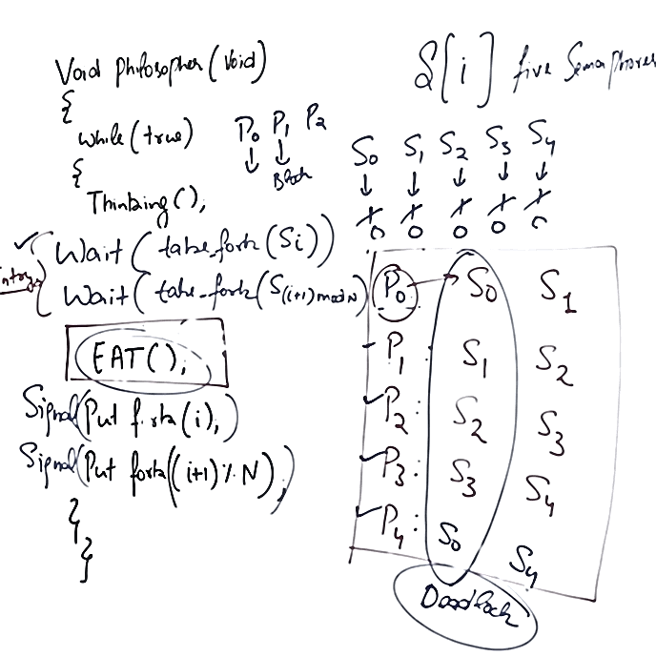


Slide 17
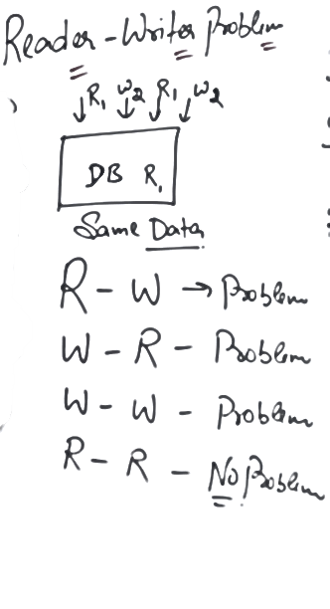
Reader Writer problem

Slide 18
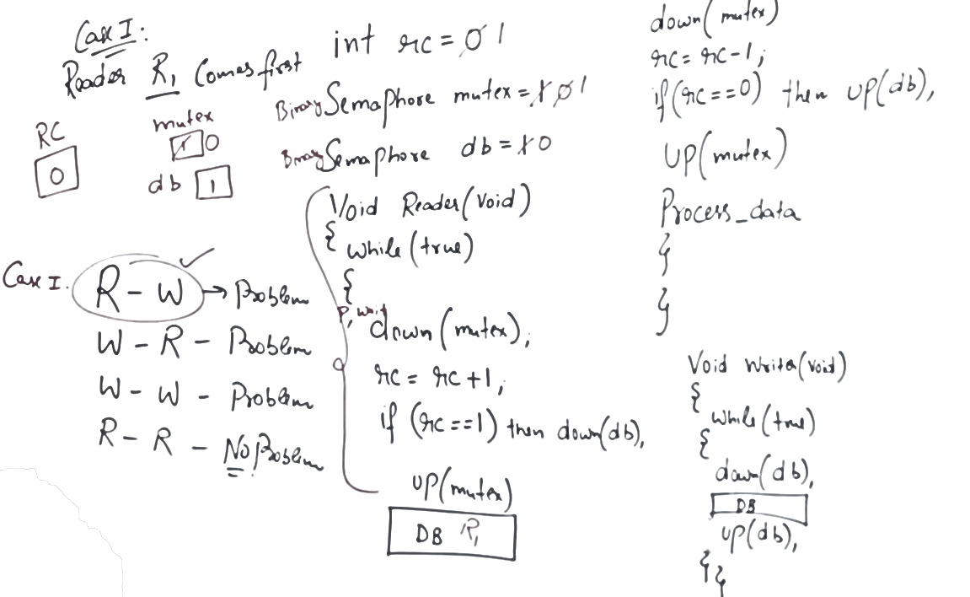


Slide 19
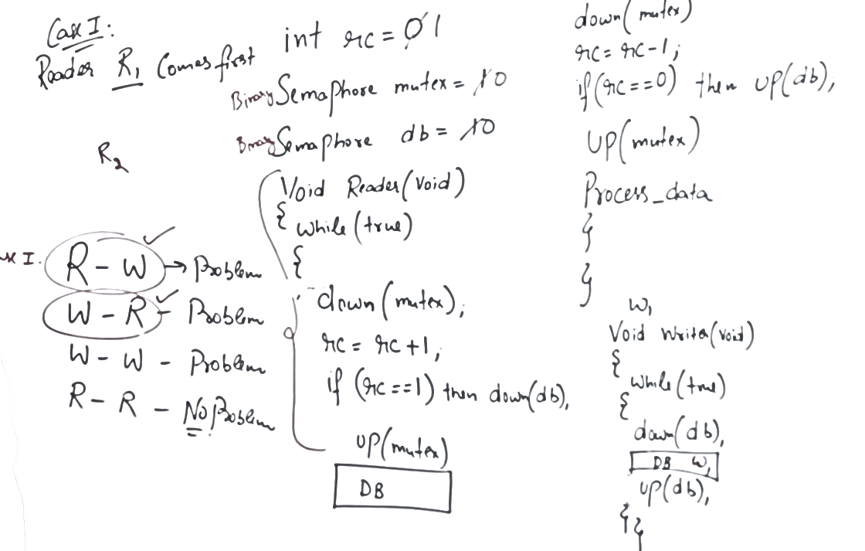
CASE II

Slide 20
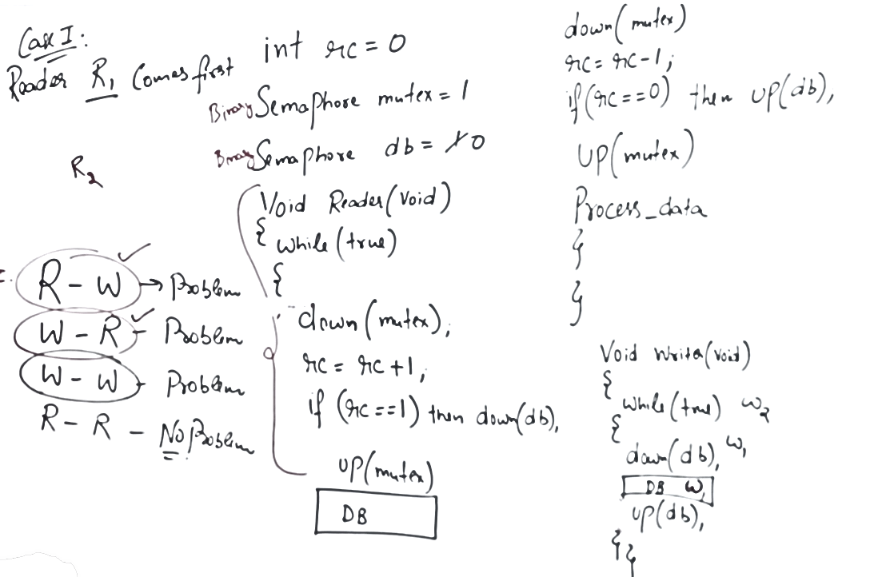
Case III

Slide 21
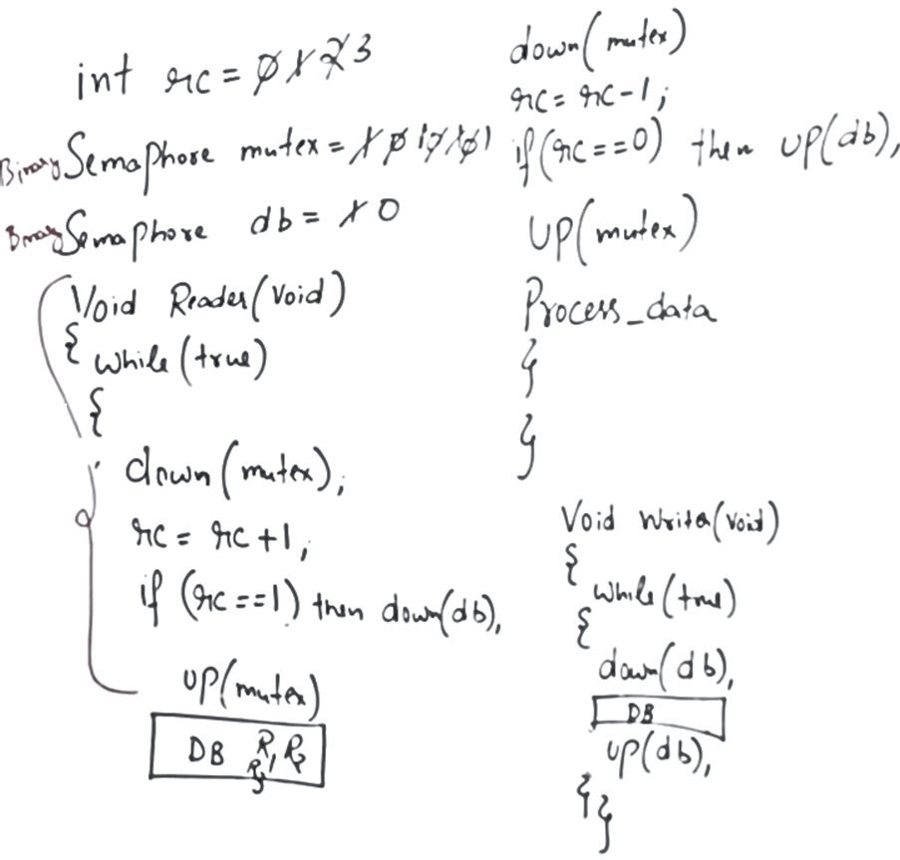
Case IV

Slide 22
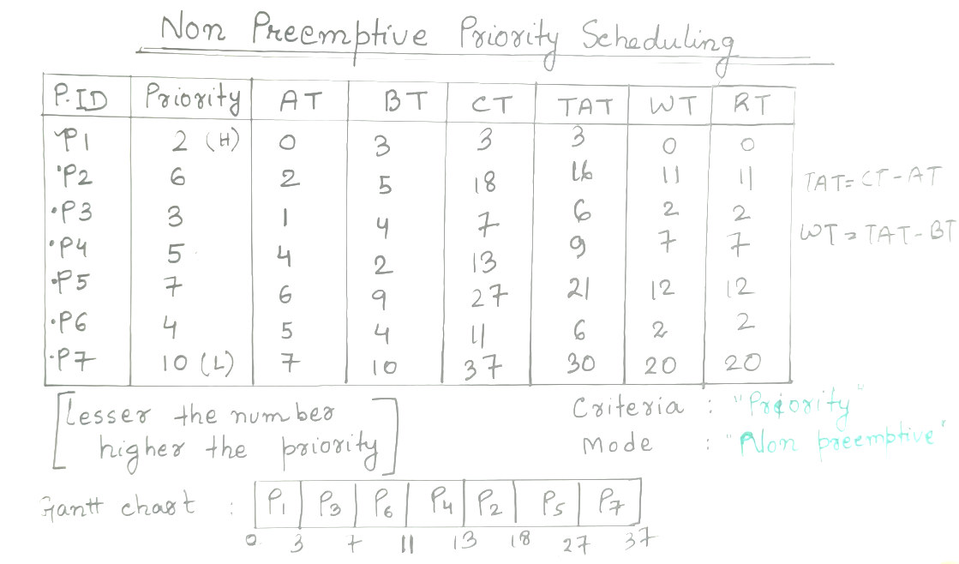

Slide 23
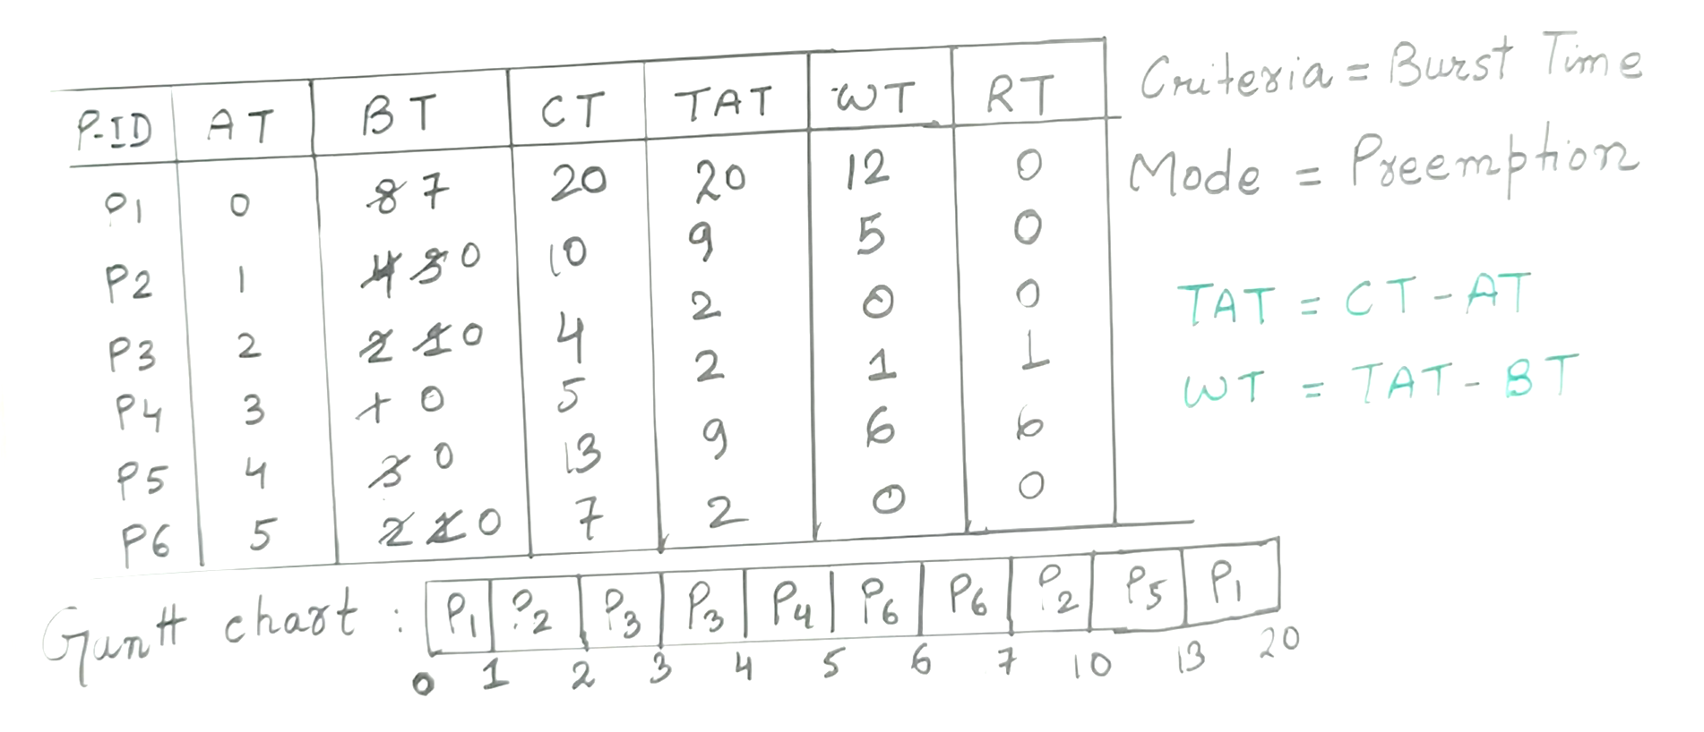
Shortest Remaining Time First (SRTF) Scheduling Algorithm

Slide 24
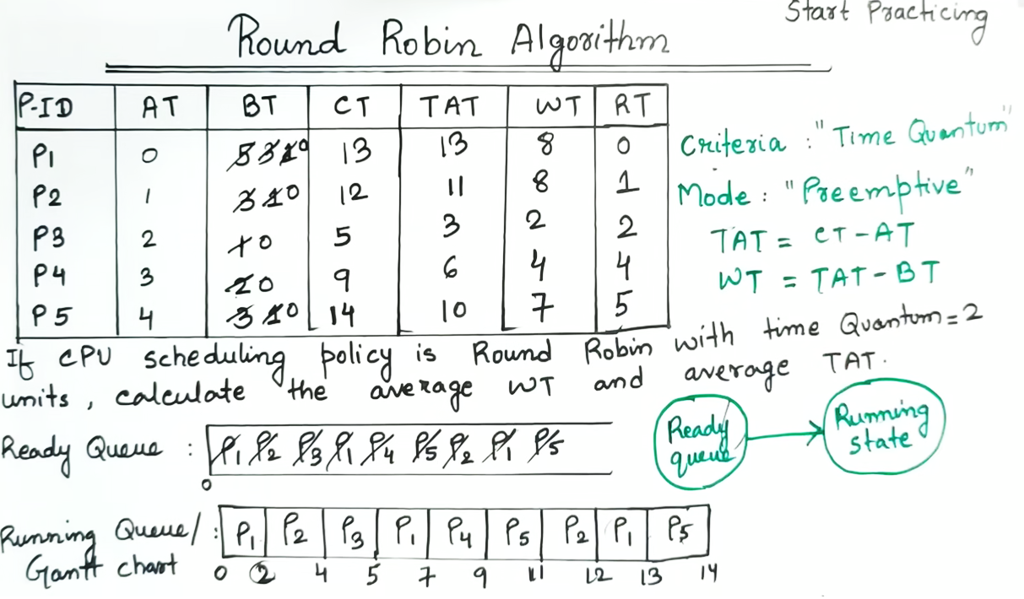

Slide 25
Inter Process Communication or IPC.
Processes frequently need to communicate with other processes.
For example, in a shell pipeline, the output of the first process must be passed to the second process, and so on down the line.
Inter-process communication (IPC) is a
mechanism that allows processes to communicate with each other and synchronize their actions.
The communication between these processes can be seen as a method of co-operation between them.
Processes can communicate with each other through both:
Shared Memory
Message passing

Slide 26
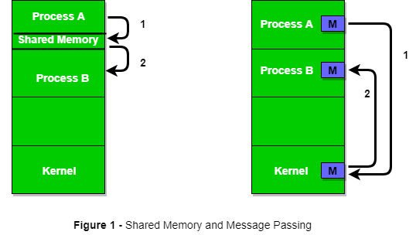
Inter Process Communication

Slide 27
Shared Memory Method
Ex: Producer-Consumer problem There are two processes: Producer and Consumer. The producer produces some items and the Consumer consumes that item. The two processes share a common space or memory location known as a buffer where the item produced by the Producer is stored and from which the Consumer consumes the item if needed.
In this method, processes communicate with each other without using any kind of shared memory. If two processes p1 and p2 want to communicate with each other, they proceed as follows:
Messaging Passing Method
Establish a communication link (if a link already exists, no need to establish it again.)
Start exchanging messages using basic primitives. We need at least two primitives: – send(message, destination) or send(message) – receive(message, host) or receive(message)

